Slide 2
VEHICLE TRACKING SYSTEM
Guided by
Prof.U.R.Ashwini
Dept. of CSE
Team Members
1. K.MANIKANTESWARA PILLAI[19BCE7298]
2. M.MIDHUN AKASH [19BCN7108]
3. M.SAHITHI [19MIS7011]
4. T.ANEEHA [19MIS7005]
5. G.VENKATA LOKESH [19BCE7776]
6. A.JOSHI KRISHNA SAI [19BCE7400]

Slide 3
AGENDA
Introduction
Raspberry Pi/Arduino
Abstract
Module Identification
Architecture Diagram
Equipment Identified
Time Line Chart
References

Slide 4
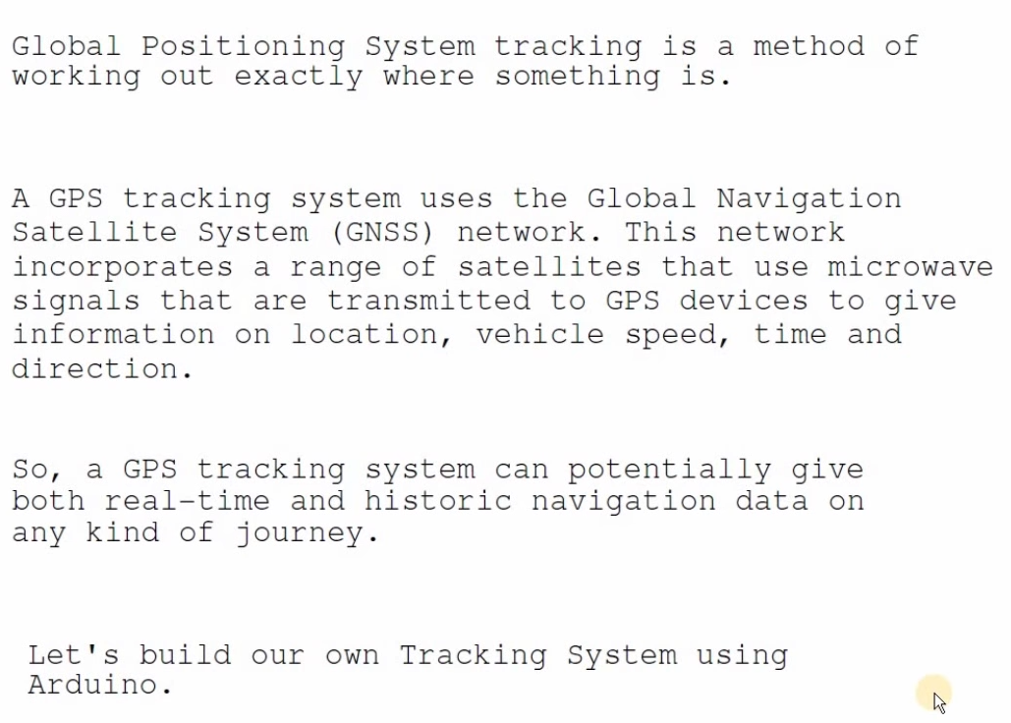
Introduction

Slide 5
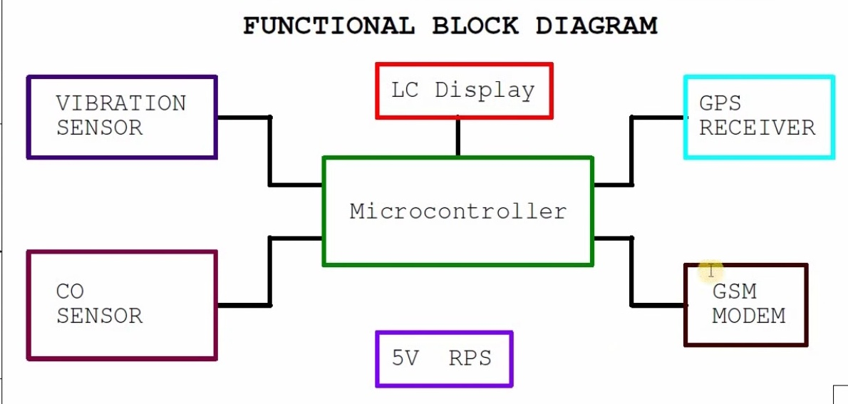
Module Identification Of Aurdino

Slide 6
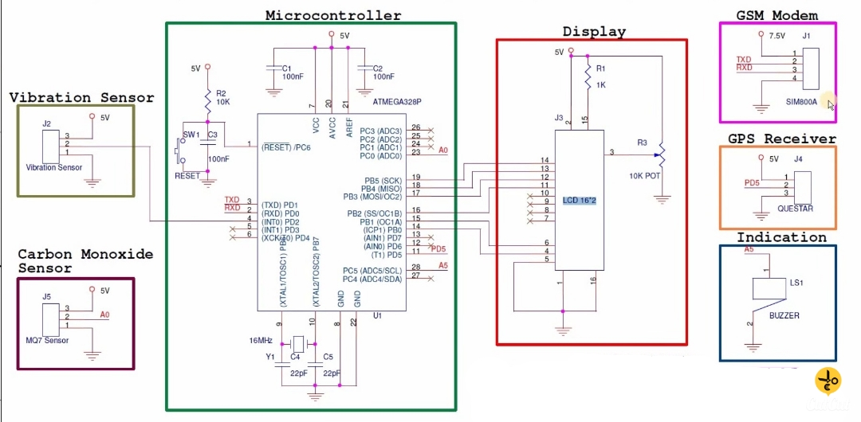
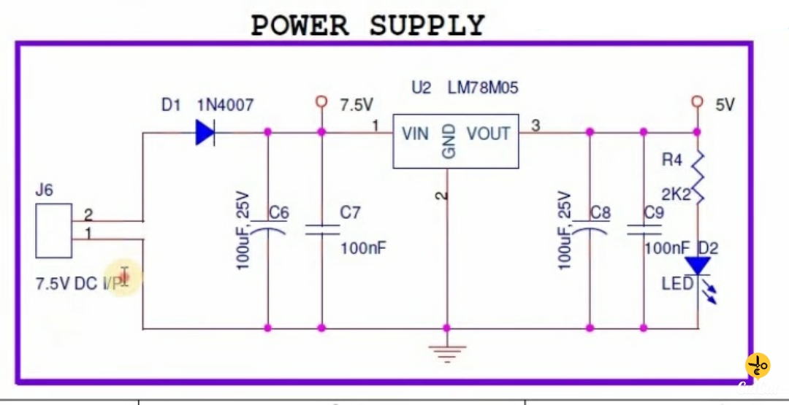
Architecture Diagram

Slide 7
Equipment Identified
Sl.No. Name Of Equipment Identified Quantity Cost
1.
2.
3.
4.
5.
6.
Arduino Uno
IPSLCD Display
GSM Modem
CO Sensor
GPS Receiver
VIBRATION Sensor
1
1
1
1
1
1
Rs.700
RS.800
RS.750
RS.700
RS.549
Rs.193

Slide 8
Timeline Chart
Delivery
Testing
Integration with IDE
Coding – Arduino IDE
Hardware Analysis
Pbm Identified
Literature Survey
Modules | Aug 1-4 Week | Sep 1st Week | Sep 2nd Week | 3rd | 4th | Oct 1st Week | 2nd | 3rd | 4th | Nov 1st Week

Slide 9
References
1. https://www.arduino.cc/en/Guide/ArduinoMega2560
2. http://playground.arduino.cc
3. https://learn.adafruit.com/category/learn-arduino
4. Sams Teach Yourself “ Arduino Programming” by Richard Blum ,Pearson Education 2015.

Slide 10
Thank You

